Slide 1
Lesson 1

Slide 2
Grammar: Noun Listening: Names
TABLE OF CONTENT

Slide 3
GRAMMAR
NOUNS

Slide 4

DEFINITIONS

Slide 5

TYPES OF NOUNS

Slide 6
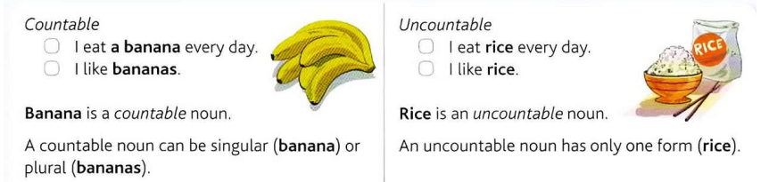

Slide 7
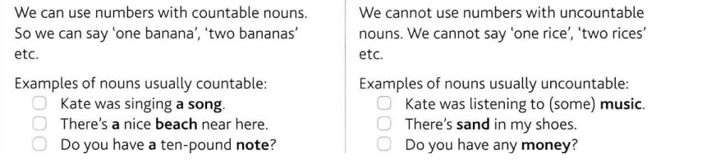
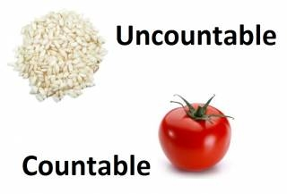

Slide 8

HOW TO FORM PLURAL NOUNS

Slide 9
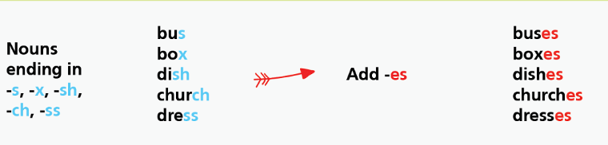
HOW TO FORM PLURAL NOUNS

Slide 10
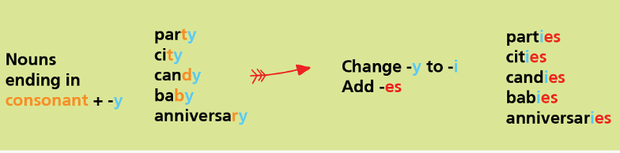
HOW TO FORM PLURAL NOUNS

Slide 11
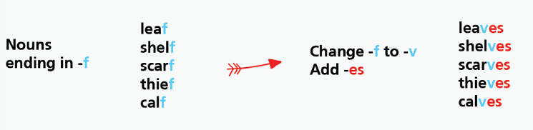
HOW TO FORM PLURAL NOUNS

Slide 12

HOW TO FORM PLURAL NOUNS

Slide 13
HOW TO FORM PLURAL NOUNS
Ends in VOWEL+0 (add –S) |  | Ends in CONSONANT+ O (add –ES)
1 zoo | 2 zoos | 1 hero | 2 heroes
1 radio | 2 radios | 1 echo | 2 echoes
1 stereo | 2 stereos | 1 tomato | 2 tomatoes
1 video | 2 videos | 1 potato | 2 potatoes
1 kangaroo | 2 kangaroos | Exceptions | Piano-pianos Photo-photos

Slide 14
HOW TO FORM PLURAL NOUNS
IRREGULAR NOUNS |  | NO CHANGE
1 man | 2 men | 1 sheep | 2 sheep
1 child | 2 children | 1 deer | 2 deer
1 foot | 2 feet | 1 fish | 2 fish
1 tooth | 2 teeth | 1 series | 2 series
1 mouse | 2 mice | 1 species | 2 species
1 person | 2 people

Slide 15
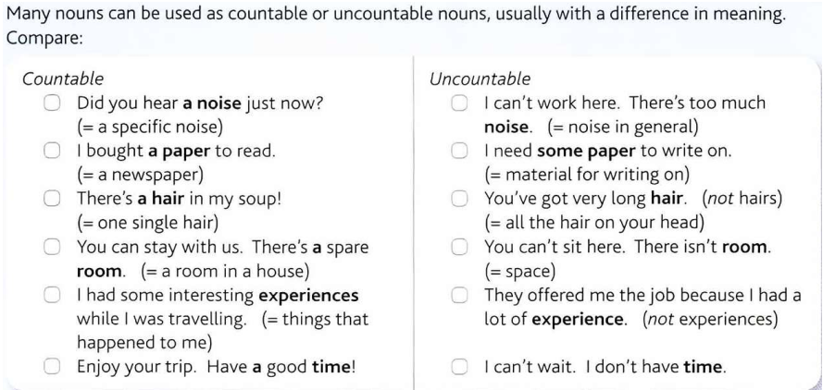

Slide 16
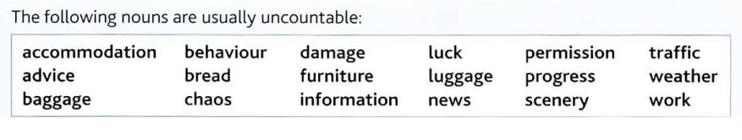
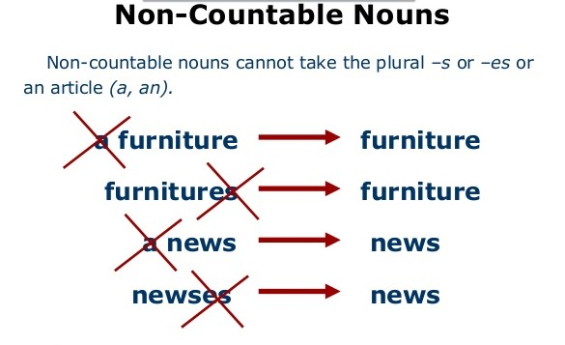

Slide 17
PRACTICE

Slide 18
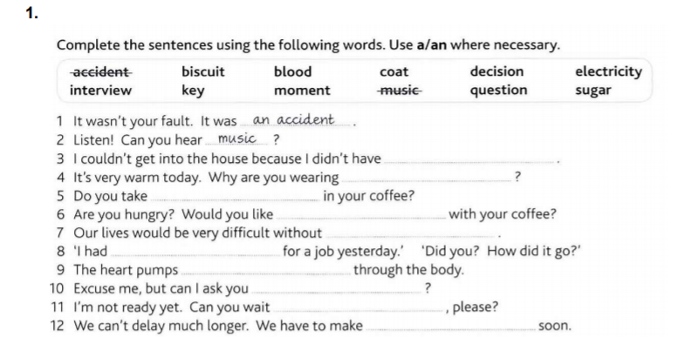
a key
a coat
sugar
a biscuit
electricity
an interview
blood
a question
a moment
a decision

Slide 19
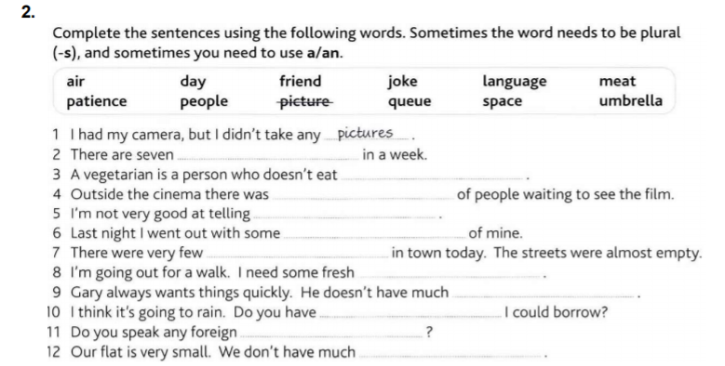
days
meat
queue
jokes
friends
people
air
patience
an umbrella
languages
space

Slide 20
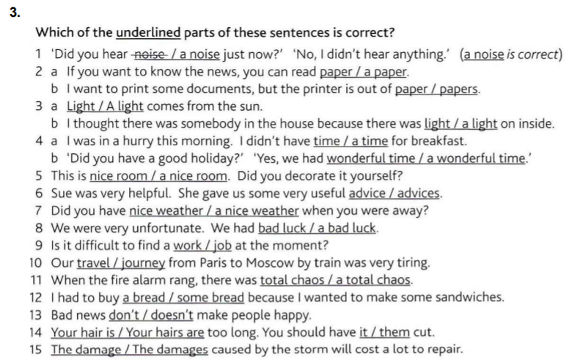

Slide 21
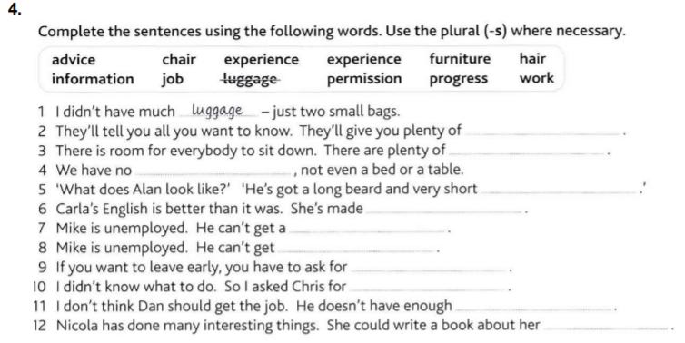
information
chairs
furniture
hair
progress
job
work
permission
advice
experience
experiences

Slide 22
THANKS!

Slide 23
HOMEWORK

Slide 24
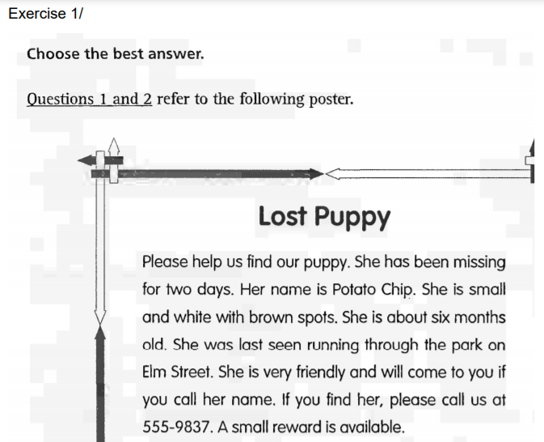

Slide 25

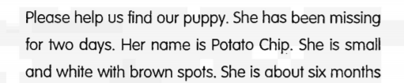
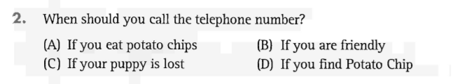


Slide 26
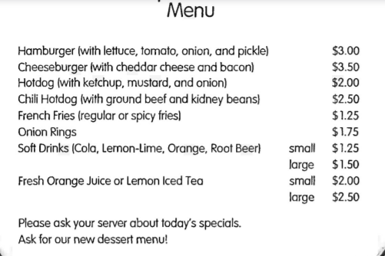

Slide 27
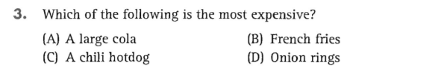

Slide 28
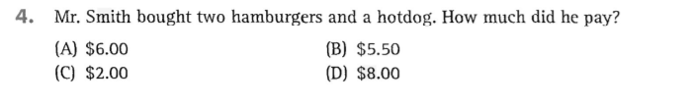

Slide 29
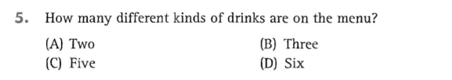

Slide 30


Slide 31
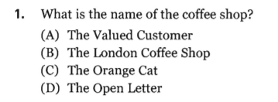

Slide 32
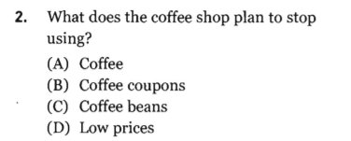


Slide 33
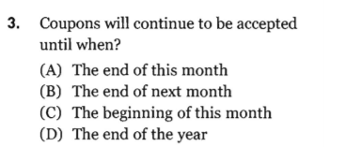

Slide 34
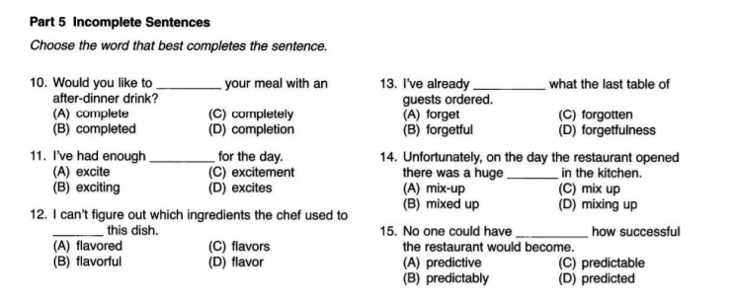

Slide 35
LISTENING

Slide 36
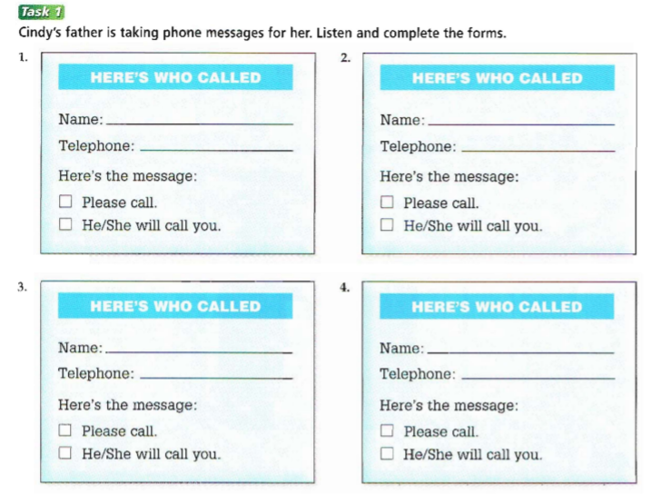
LISTENING
Bob Jackson
Nancy
691-3839
391-8246
√
√
Brian Kennedy
Miss Wilson
271-8914
√
√

Slide 37
